Slide 1
Ecommerce Capstone Project (Mid Submission)
Group Members:
Merin Jose
Suresh Balla
Deepak Aneja
Fayiz Mayam Veettil
23 Sep 2018

Slide 2
Table of Contents
Business Understanding
Data Understanding
Data Preparation
Modelling
Recommendations

Slide 3
Business Understanding
“ElecKart” is an e-commerce firm specializing in electronic products. They spent a significant amount of money in marketing and occasionally they offer big-ticket promotions as well. It take orders and delivers at door steps and deal with all major electronics product categories - Camera, Home Audio & Gaming Accessories
The money ElecKart spent over last 12 months on marketing was not sufficiently impactful. Now they want to create a marketing budget for the next year which includes spending on commercials, online campaigns, and pricing & promotion strategies and maximum revenue out of it.
The key objectives of the analysis are:
Develop a market mix model to observe the actual impact of different marketing variables over the last year
Recommend the optimal budget allocation for different marketing levers for the next year
Improve the revenue response either by cutting down the marketing budget or reallocating it optimally across marketing levers

Slide 4
Data Understanding
Dataset contains around 1.6 M records of Consumer Electronics data from July 2015 to June 2016
Other available datasets are
Media Investments
Special Sale Calendar
Monthly NPS Score
Product sub-categories used for analysis are
Camera Accessory
Home Audio
Gaming Accessory

Slide 5
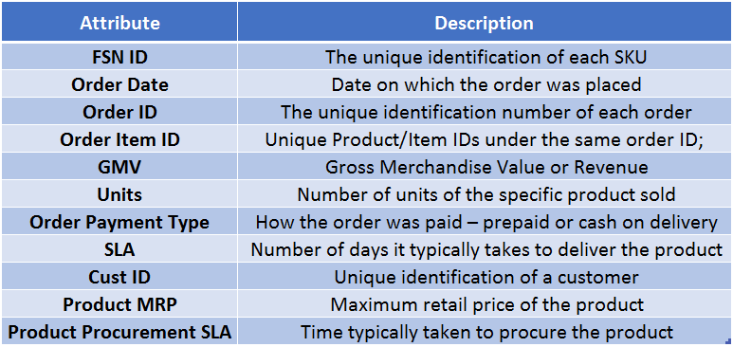
Data Understanding – Major Attributes
The data received for the analysis have 20 attributes. The important ones are -

Slide 6
Data Understanding – Additional Information
apart from consumer data following addition information received for model building
Monthly spends on various advertising channels –
Monthly spends split by various medias types such as TV, Internet, Radio and Others
Days when there was any special sale –
Information about the special sale calendar
Monthly NPS score –
Net promote score by month

Slide 7
Step by Step Approach for Analysis
Cleaning and formatting data
Derive useful metrics out of data
Check the data density and correlations
Data Scaling
Splitting the data between train and test
Data Modeling
Conclusion

Slide 8
Exploratory Data Analysis – Data Cleaning
Check for possible data inconsistencies
Check for duplicate records
Check for NA values in the columns used for analysis
Check the period of the provided data
Status of data cleaning
Around 100K records found duplicated and removed from the dataset
Around 4K removed where Gross Merchandise Value is Null
Removed the data which are not in the period used for analysis
Below columns where removed after applying Near Zero Variances
units, product_analytics_super_category
Filtered out the records to 526K after applying the

Slide 9
Exploratory Data Analysis – Derived Metrics
Below the new columns derived for further analysis
Offer Price = (Product MRP * Unit Sold) – Gross Merchandise Value or Revenue
Week Number, week number of the year ranging from 0-53 with Monday as first day of the week
Day, day of the month ranging from 0-31

Slide 10
Categorical Vs Numerical Variables
Below the list of categorical and numerical variables considered for further analysis
Categorical Variables
s1_fact.order_payment_type
product_analytic_category
product_analytic_sub_category
product_analytic_vertical
Year
Month
Numerical Variables
gmv
deliverybdays
deliverycdays
sla
pincode
product_mrp
product_procurement_sla
offer_price

Slide 11
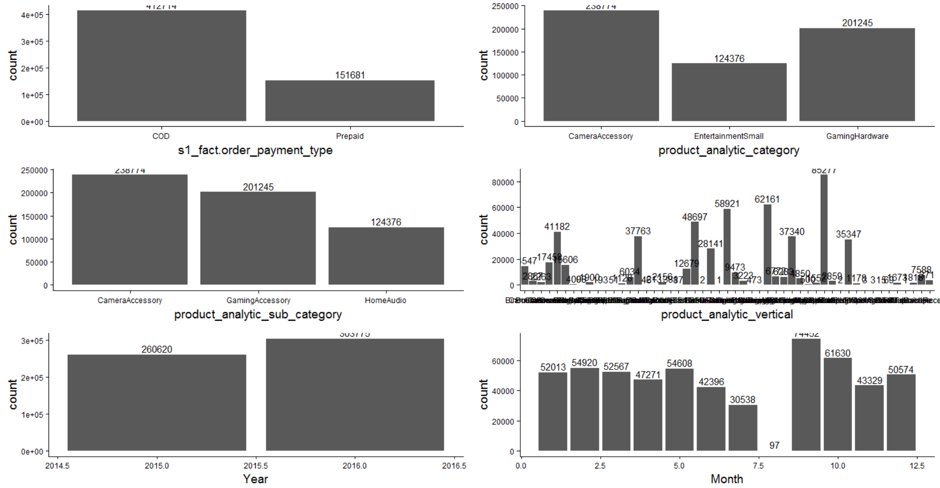
Univariate Analysis – Categorical Variables

Slide 12
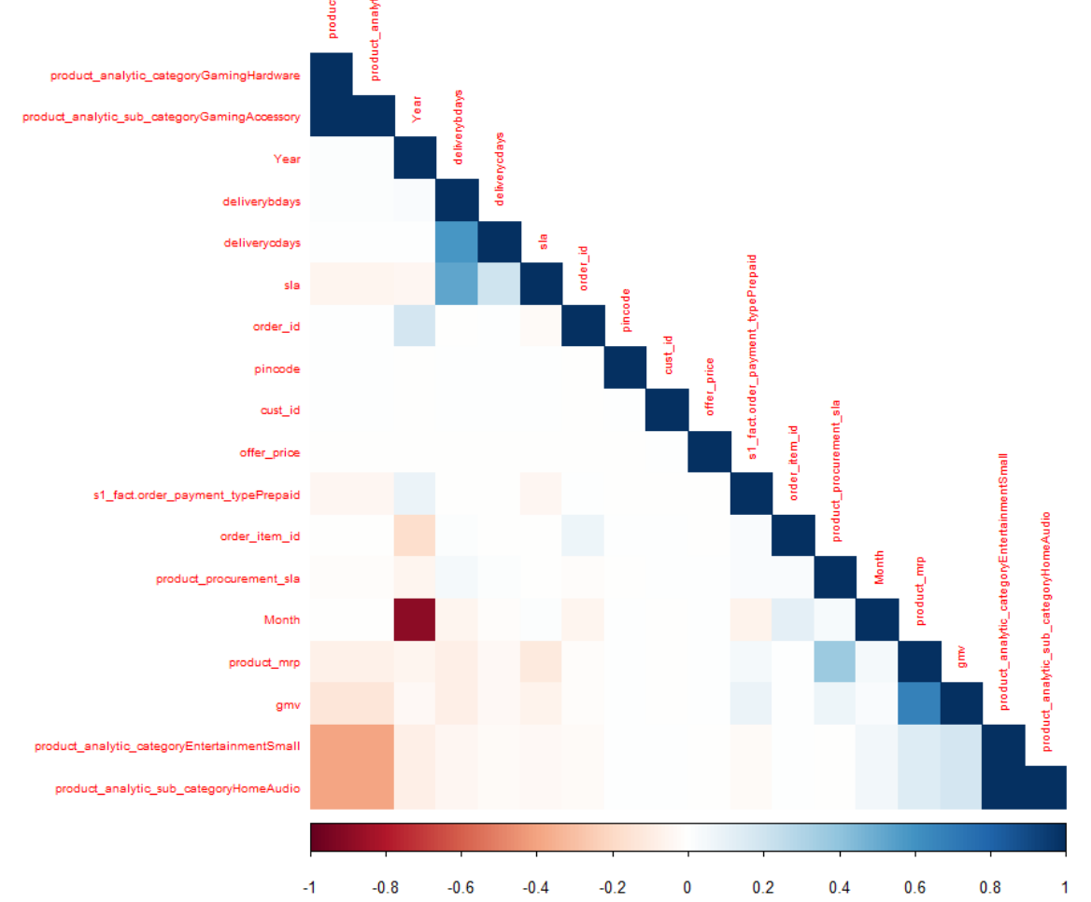
Bivariate Analysis – Correlation Plot

Slide 13
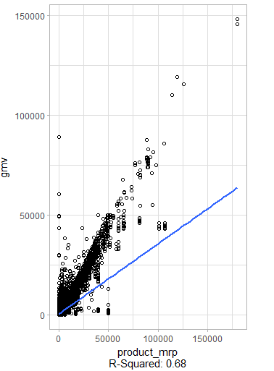
Bivariate Analysis – High Correlated Variable
Product_MRP showed high correlated to GMV

Slide 14
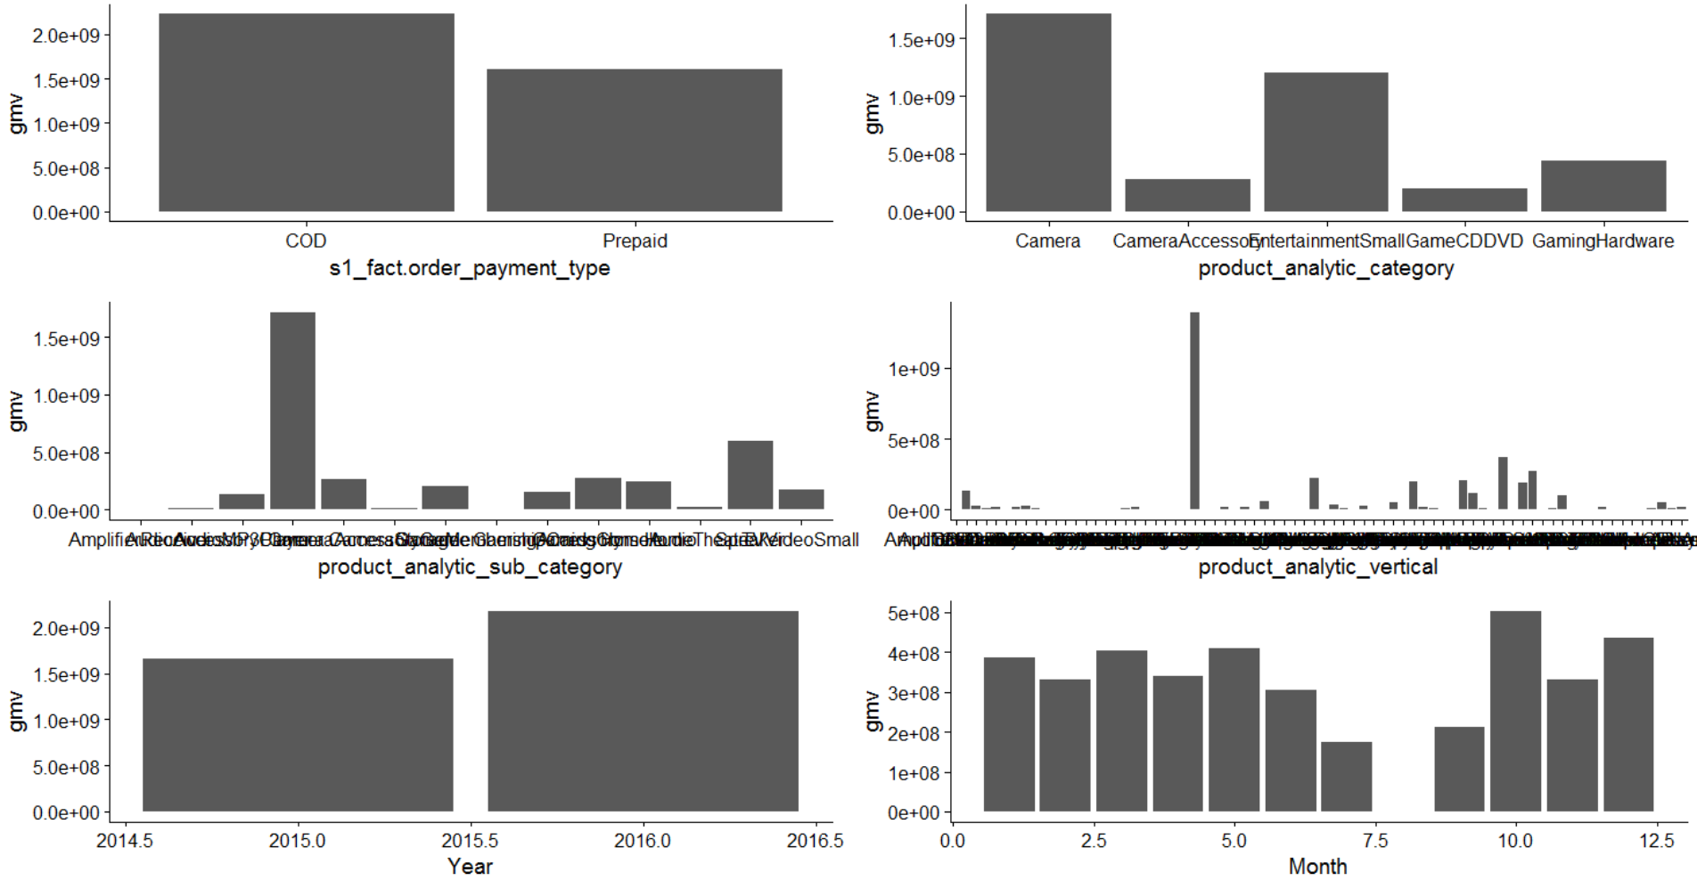
Aggregated Plots
Plots explains the aggregation of
different values of the Categorical Variables

Slide 15
Aggregation Strategy
Strategies applied to aggregate the data are
Aggregate By day
Year, Month and Day variables used to GROUP the dataset
Applied SUM function for GMV, Product MRP, Offer Price and other numerical variables
Applied MEAN* function for deliverybdays, deliverycdays, product_procurement_sla variables
Aggregate By Week
Year and Week variables used to GROUP the dataset
Applied SUM function for GMV, Product MRP, Offer Price and other numerical variables
Applied MEAN* function for deliverybdays, deliverycdays, product_procurement_sla variables
*since these variables are represents the number of days applying SUM function is not logical hence used MEAN function

Slide 16
Weekly Analysis

Slide 17
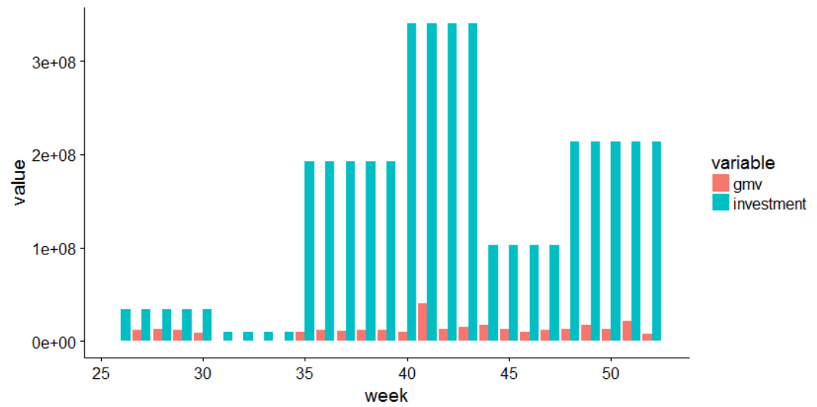
Weekly Analysis, 2015 – Revenue Vs Investments
Weekly Revenue vs. Investments Analysis from July – Dec 2016 (Week# 26-52)

Slide 18
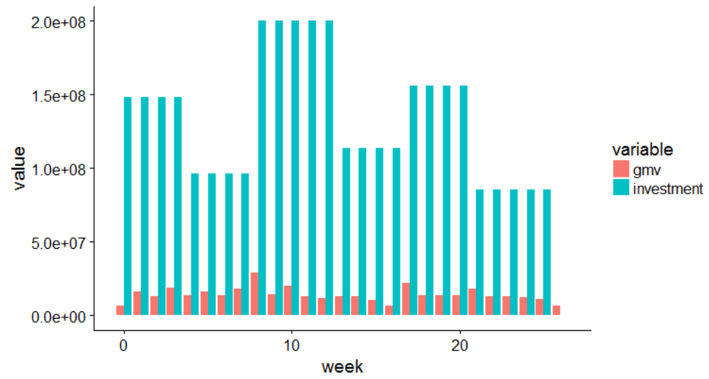
Weekly Analysis, 2016 – Revenue Vs Investments
Weekly Revenue vs. Investments Analysis from Jan – Jun 2015 (Week # 0-25)

Slide 19
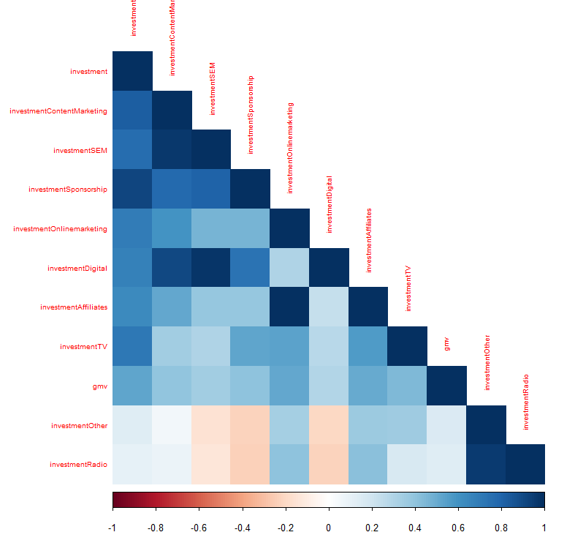
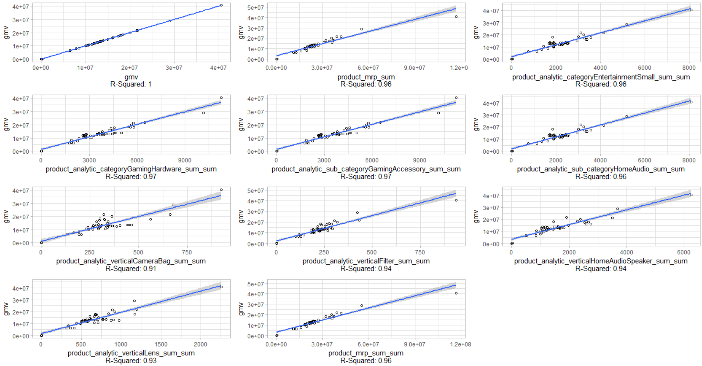
Weekly Analysis, High Correlated Variables
Highly correlated variables with GMV at week level
Highly correlated variables with Investments

Slide 20
Modelling

Slide 22
Thanks
Merin Jose
Suresh Balla
Deepak Aneja
Fayiz Mayam Veettil

